Slide 1
Second-Quarter 2016
Performance Review
Dennis Muilenburg
Chairman, President and Chief Executive Officer
Greg Smith
Chief Financial Officer
Executive Vice President, Corporate Development & Strategy
July 27, 2016

Slide 2
Second-Quarter Summary
Strong commercial deliveries and solid underlying operating performance
Generated $3.2B of operating cash; completed $2B share repurchase
Results reflect 787 R&D reclassification and 747 and KC-46 Tanker charges
Continued focus on cost reductions and productivity improvements
Proven product strategy; converting backlog into profitable growth
Healthy commercial airplane orders; key defense awards
Solid results offset by charges; executing cash deployment strategy

Slide 3
Business Environment
Global economic growth continues at a moderate pace
Solid passenger traffic; air cargo market remains weak
Airline profitability driving healthy demand for aircraft
Commercial aviation remains long-term growth industry
Stabilizing U.S. defense budgets; solid support for our major programs
International defense growth opportunities
Commercial up-cycle progressing; stabilizing defense environment

Slide 4
Second-Quarter Revenue and Earnings
Revenue (Billions)
*
Core Earnings/(Loss) per Share
KC-46 Tanker Charge
($0.77)
787 R&D Reclassification
($1.33)
747 Charge
($1.28)
KC-46 Tanker Charge
($0.62)
$1.62
* Non-GAAP measures. Reconciliations and additional information regarding non-GAAP measures are provided on slide 12.
Solid underlying operating performance on production and services

Slide 5
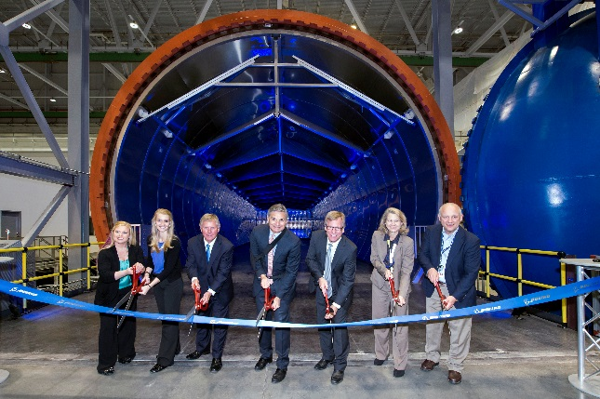
Commercial Airplanes
Delivered 199 airplanes
Orders valued at $11B; robust backlog of $417B
  Won 152 net orders
  Opened 777X Composite Wing Center
  Delivered first 787 at 12 per month rate
  Declared 787-10 production ready
  Rolled out first two 737 MAX production airplanes
  Completed 737 MAX 7 Firm Configuration
Revenues & Operating Margins
Revenue (billions)
Margin
(5.6%)
310 basis point
Tanker impact
1,590 basis point
787, 747 and Tanker impact
Composite Wing Center Grand Opening
Focusing on execution, quality and productivity

Slide 6
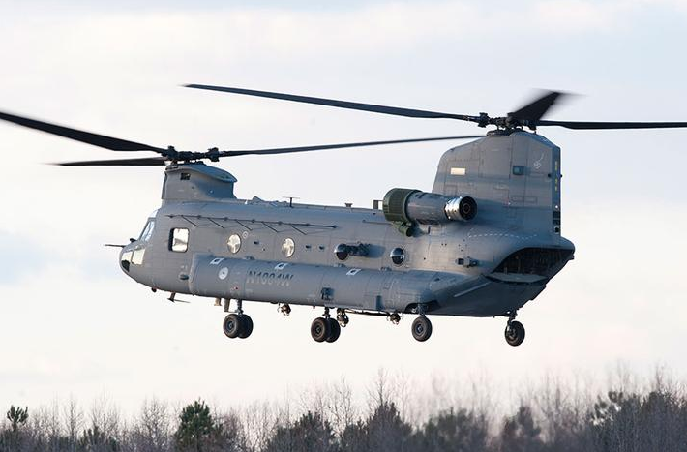
Defense, Space & Security
Revenues & Operating Margins
  Capturing new and follow-on business
  Order for 12 H-47 Chinook aircraft for the Netherlands
  Contract award for 24 Qatar AH-64E Apache aircraft
  Congressional support for additional F/A-18s
  Executing balanced portfolio
  Delivered 44 aircraft* and 1 satellite
  First flight of KC-46 Tanker production aircraft
Orders valued at $6B; Backlog of $55B
Revenue (billions)
Margin
430 basis point
Tanker impact
300 basis point
Tanker impact
*Includes new, remanufactured and renewed aircraft
H-47 Chinook
Focused on execution and meeting customers’ needs

Slide 7
Cash Flow
$ Billions |  | 2Q15 |  | 2Q16
Net Earnings/(Loss) |  | 1.1 |  | (0.2)
Depreciation/non-cash |  | 0.6 |  | 0.6
Working Capital |  | 1.6 |  | 2.8
Operating Cash Flow |  | 3.3 |  | 3.2
  Solid operating performance
Continuing to drive disciplined cash management
Repurchased 15 million shares in 2Q16 for $2 billion and paid $0.7 billion in dividends
Strong cash flow; continued capital deployment to shareholders

Slide 8
Cash and Debt Balances
Cash
S&P: A
Moody’s: A2
Fitch: A
Boeing debt
Billions
Marketable Securities
Billions
BCC debt
$9.3
$8.4
Strong liquidity with manageable debt levels

Slide 9
Financial Guidance
 | 2016
Revenue | $93.0 – 95.0B
Core EPS | $8.15 – 8.35
Operating Cash Flow | ~$10B
$6.10 – 6.30
*
* Non-GAAP measure. Definitions, reconciliations, and further disclosures regarding this non-GAAP measure are provided in the company’s earnings press release dated July 27, 2016.
EPS guidance reflects reclassification, charges & solid performance

Slide 10
Caution Concerning Forward-Looking Statements
This document contains “forward-looking statements” within the meaning of the Private Securities Litigation Reform Act of 1995. Words such as “may,” “should,” “expects,” “intends,” “projects,” “plans,” “believes,” “estimates,” “targets,” “anticipates,” and similar expressions are used to identify these forward-looking statements. Examples of forward-looking statements include statements relating to our future financial condition and operating results, as well as any other statement that does not directly relate to any historical or current fact. Forward-looking statements are based on our current expectations and assumptions, which may not prove to be accurate. These statements are not guarantees and are subject to risks, uncertainties, and changes in circumstances that are difficult to predict. Many factors could cause actual results to differ materially and adversely from these forward-looking statements. Among these factors are risks related to: (1) general conditions in the economy and our industry, including those due to regulatory changes; (2) our reliance on our commercial airline customers; (3) the overall health of our aircraft production system, planned production rate increases across multiple commercial airline programs, our commercial development and derivative aircraft programs, and our aircraft being subject to stringent performance and reliability standards; (4) changing budget and appropriation levels and acquisition priorities of the U.S. government; (5) our dependence on U.S. government contracts; (6) our reliance on fixed-price contracts; (7) our reliance on cost-type contracts; (8) uncertainties concerning contracts that include in-orbit incentive payments; (9) our dependence on our subcontractors and suppliers, as well as the availability of raw materials, (10) changes in accounting estimates; (11) changes in the competitive landscape in our markets; (12) our non-U.S. operations, including sales to non-U.S. customers; (13) potential adverse developments in new or pending litigation and/or government investigations; (14) customer and aircraft concentration in Boeing Capital’s customer financing portfolio; (15) changes in our ability to obtain debt on commercially reasonable terms and at competitive rates in order to fund our operations and contractual commitments; (16) realizing the anticipated benefits of mergers, acquisitions, joint ventures/strategic alliances or divestitures; (17) the adequacy of our insurance coverage to cover significant risk exposures; (18) potential business disruptions, including those related to physical security threats, information technology or cyber-attacks or natural disasters; (19) work stoppages or other labor disruptions; (20) significant changes in discount rates and actual investment return on pension assets; (21) potential environmental liabilities; and (22) threats to the security of our or our customers’ information.
Additional information concerning these and other factors can be found in our filings with the Securities and Exchange Commission, including our most recent Annual Report on Form 10-K, Quarterly Reports on Form 10-Q and Current Reports on Form 8-K. Any forward-looking statement speaks only as of the date on which it is made, and we assume no obligation to update or revise any forward-looking statement, whether as a result of new information, future events, or otherwise, except as required by law.

Slide 12
Non-GAAP Measure Disclosure

